Slide 1



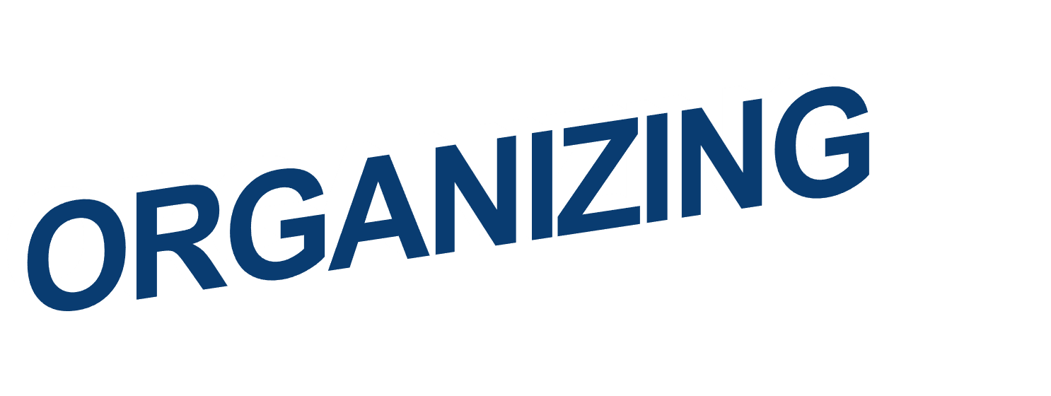




Slide 2













Key concepts definition
Building up organizational structure
Types of structure
Centralization and decentralization
Jobs allocation and its structure
01
Jens Martensson

Slide 3


Describe six key elements in organizational design.
Contrast mechanistic and organic structures.
Discuss the contingency factors that favor either the mechanistic model or the organic model of organizational design.
Describe traditional organizational designs.
01
Jens Martensson

Slide 4
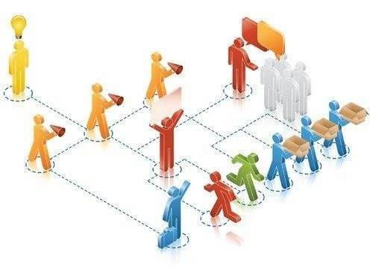

DESIGNING ORGANIZATIONAL STRUCTURE
Organizing – arranging and structuring work to accomplish an organization’s
goals.
Organizational structure – the formal arrangement of jobs within an organization.
03
Jens Martensson4

Slide 5
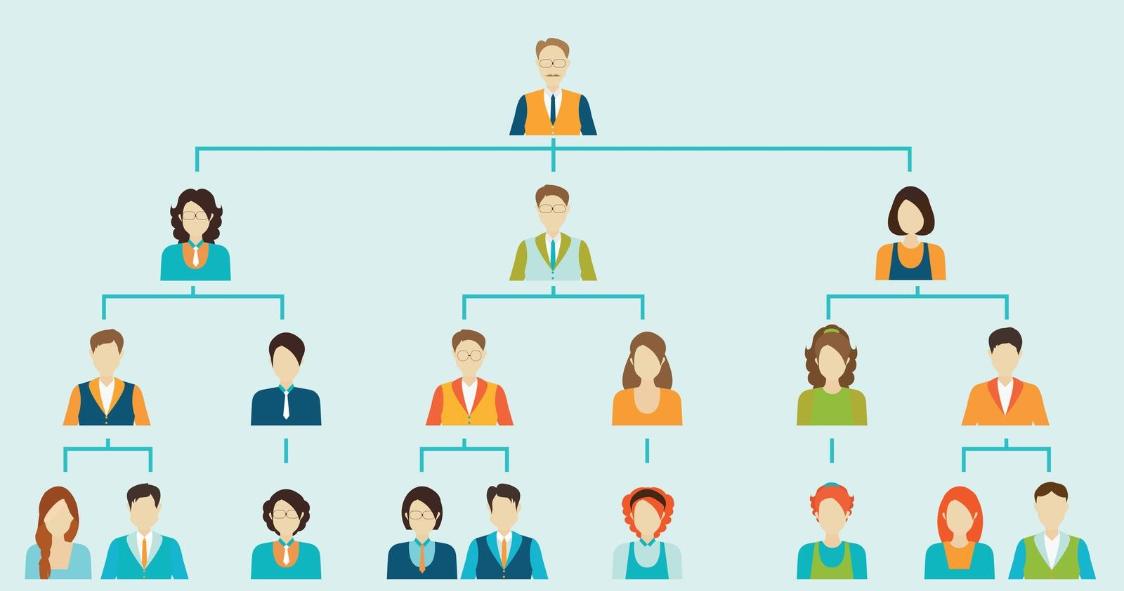
DESIGNING ORGANIZATIONAL STRUCTURE
Organizational chart – the visual representation of an organization’s structure.
Organizational design – Creating or changing an organization’s structure.
03
Jens Martensson4

Slide 6
DESIGNING ORGANIZATIONAL STRUCTURE
Organizational design involves decisions about six key elements:
Work specialization
Departmentalization
Chain of command
Span of control
Centralization and decentralization
Formalization.
04
Jens Martensson6

Slide 7
WORK SPECIALIZATION
Work specialization - Dividing work activities into separate job tasks.
Job is broken down into a number of steps
Each step is completed by a separate individual
Makes efficient use of the diversity of skills that workers have
05
Jens Martensson7

Slide 8

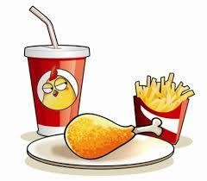
WORK SPECIALIZATION
Take order
Cook
Get drink
Package
Deliver/ Serve
06
Jens Martensson8

Slide 9
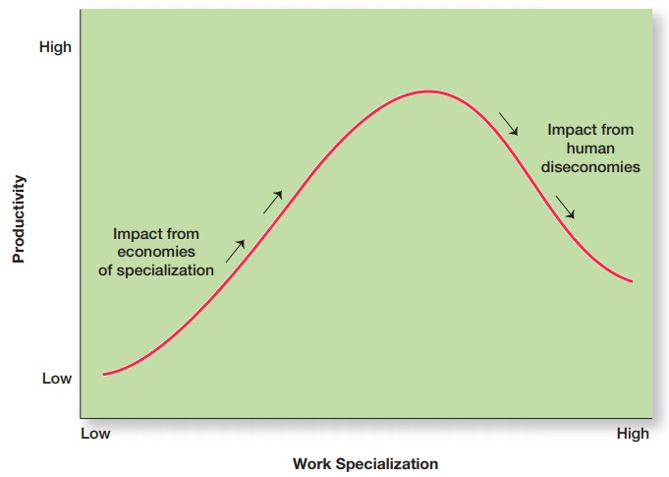
WORK SPECIALIZATION
07
Jens Martensson9

Slide 10
CHAIN OF COMMAND
Chain of command - The continuous line of authority that extends from upper levels of an organization to the lowest levels of the organization clarifies who reports to whom.
Authority: the rights inherent in a managerial position to tell people what to do and to expect them to do it.
Line authority: authority that entitles a manager to direct the work of an employee.
Staff authority: positions with some authority that have been created to support, assist, and advise those holding line authority.
Jens Martensson10

Slide 11
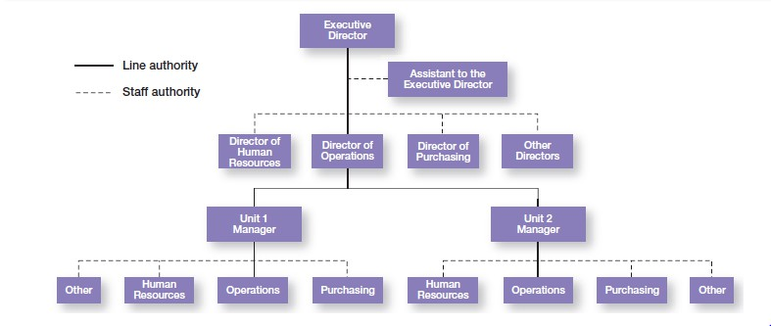
CHAIN OF COMMAND
Jens Martensson10

Slide 12
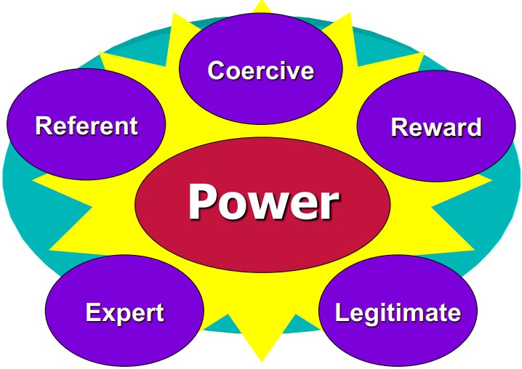
CHAIN OF COMMAND
Jens Martensson10

Slide 13
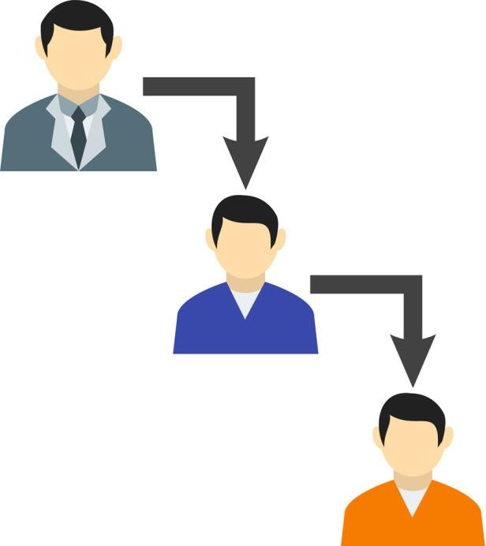
CHAIN OF COMMAND
Responsibility – the obligation or expectation to perform. It goes hand-in- hand with authority.
Unity of command – the management principle that each person should report to only one manager.
Jens Martensson10

Slide 14

SPAN OF CONTROL
Span of control – the number of employees who can be effectively and efficiently supervised by a manager.
A firm with around 4,000 employee: with span of control of 8 and 4, how many managers and levels of management are there?
18
Jens Martensson14

Slide 15
SPAN OF CONTROL
Highest
Span of control = 4
Span of control = 8
Organizational level
1
1
….…
…..
4096
4096
Lowest
18
Jens Martensson14

Slide 16
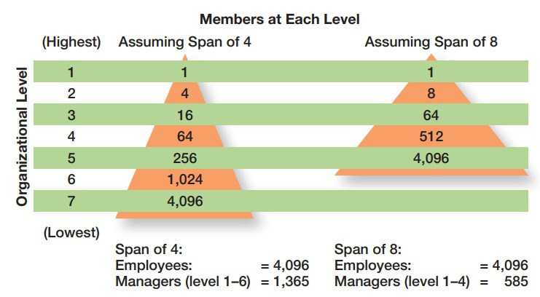
SPAN OF CONTROL
Jens Martensson16

Slide 17
CENTRALIZATION AND DECENTRALIZATION
Centralization – the degree to which decision-making is concentrated at the
upper levels of the organization.
Decentralization – the degree to which lower-level employees provide input or actually make decisions.
Employee empowerment – giving employees more authority (power) to
make decisions.
Jens Martensson16

Slide 18
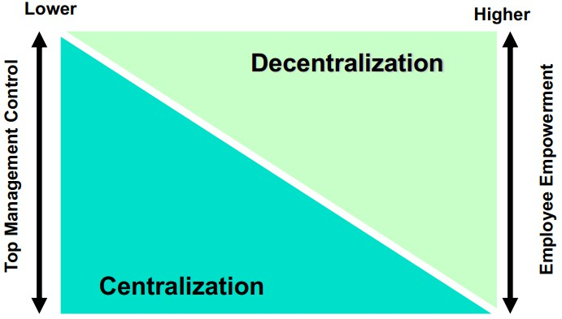
CENTRALIZATION AND DECENTRALIZATION
Jens Martensson18

Slide 19
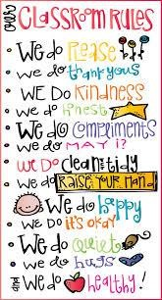
FORMALIZATION
Formalization - The degree to which jobs within the organization are standardized and the extent to which
employee behavior is guided by rules and procedures.
Highly formalized jobs offer little
discretion over what is to be done.
Low formalization means fewer
constraints on how employees do their work.
Jens Martensson18

Slide 20
DEPARTMENTALIZATION
Departmentalization - The basis by which jobs are grouped together
Functional
– Grouping jobs performed
Product
Process
– Grouping jobs on the basis of product or customer flow
Customer
by functions
– Grouping jobs by product line
Geographical
– Grouping jobs on the basis of territory or geography
– Grouping jobs by type of customer and needs
08
Jens Martensson20

Slide 21
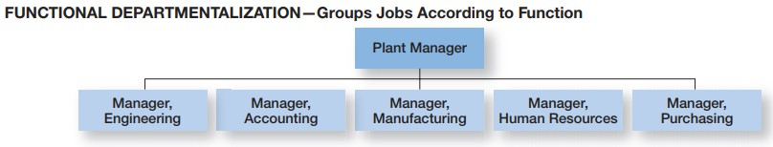
DEPARTMENTALIZATION
09
Jens Martensson21

Slide 22
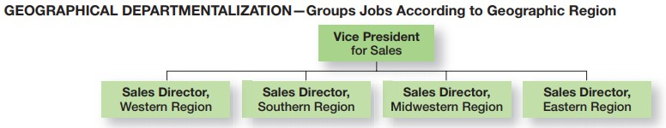
DEPARTMENTALIZATION
Jens Martensson22

Slide 23
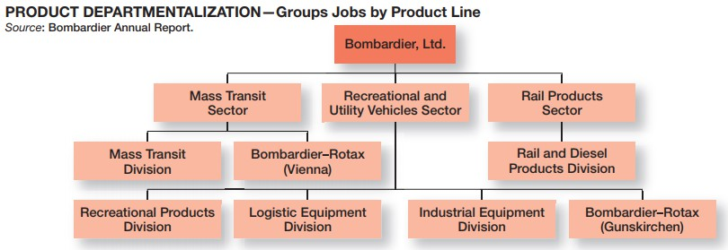
DEPARTMENTALIZATION
Jens Martensson22

Slide 24
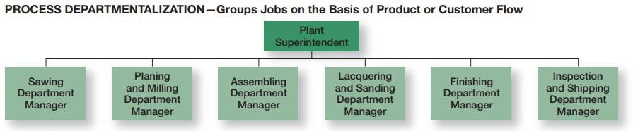
DEPARTMENTALIZATION
Jens Martensson22

Slide 25
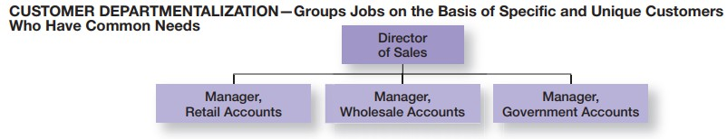
DEPARTMENTALIZATION
Jens Martensson22

Slide 26
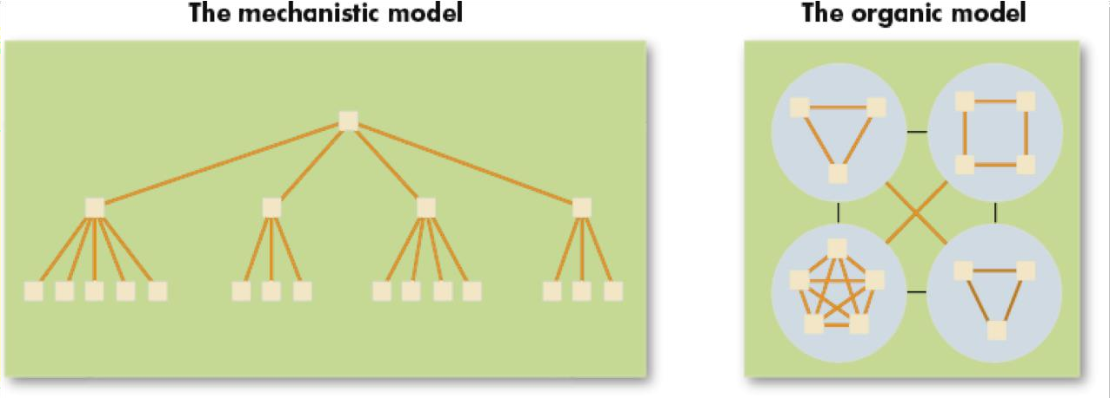
MECHANISTIC AND ORGANIC STRUCTURES
Mechanistic organization – an organizational design that’s rigid and tightly controlled.
Organic organization – an organizational design that’s highly adaptive and flexible.
Jens Martensson26

Slide 27
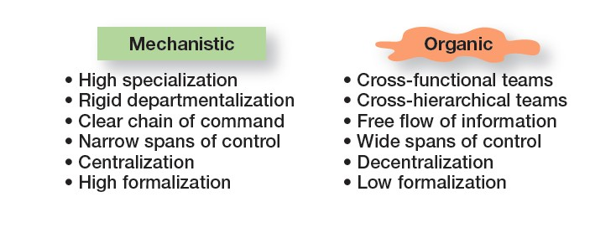
MECHANISTIC AND ORGANIC STRUCTURES
Jens Martensson26

Slide 28
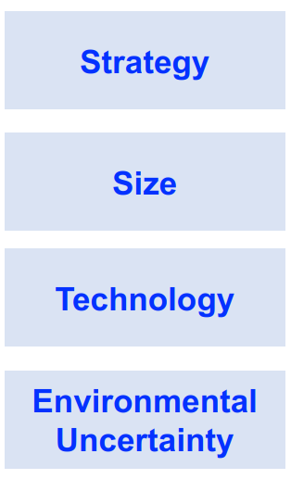




CONTINGENCY FACTORS AFFECTING STRUCTURAL CHOICE
2000 employees vs
20 employees
dynamic and complex
stable and simple
innovation
Jens Martensson26

Slide 29
TRADITIONAL ORGANIZATIONAL DESIGN OPTIONS
Simple structure – an organizational design with low departmentalization, wide spans of control, centralized authority, and little formalization.
Functional structure – an organizational design that groups together similar or related occupational specialties.
Divisional structure – an organizational structure made up of separate,
semiautonomous units or divisions.
Jens Martensson26

Slide 30
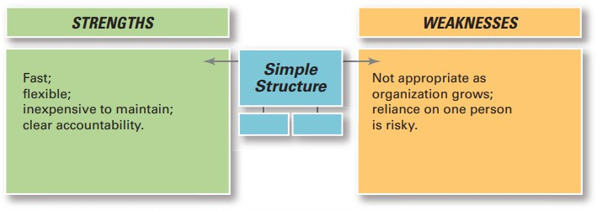
TRADITIONAL ORGANIZATIONAL DESIGN OPTIONS
Jens Martensson26

Slide 31
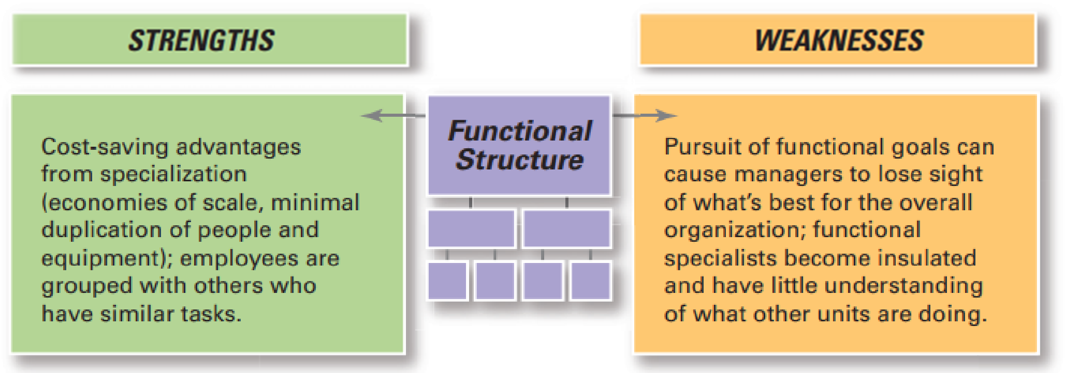
TRADITIONAL ORGANIZATIONAL DESIGN OPTIONS
Jens Martensson26

Slide 32
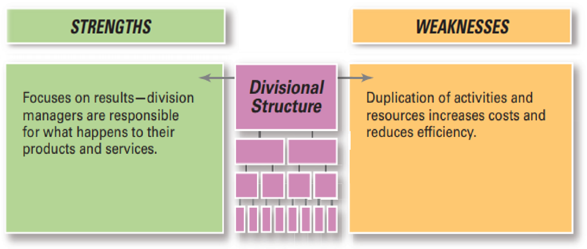
TRADITIONAL ORGANIZATIONAL DESIGN OPTIONS
Jens Martensson26

Slide 33
ORGANIZING FOR FLEXIBILITY IN THE 21ST CENTURY
Matrix and Project Structures:
+ Matrix structure:An organizational structure that assigns specialists from different functional departments to work on one or more projects
+ Project structure: An organizational structure in which employees continuously work on projects
Jens Martensson26

Slide 34
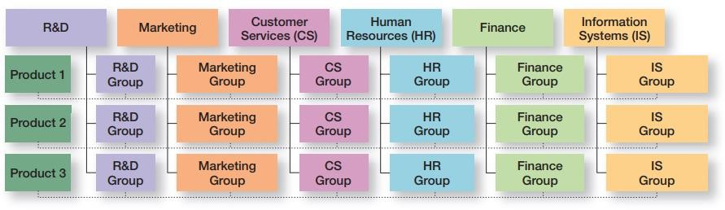
ORGANIZING FOR FLEXIBILITY IN THE 21ST CENTURY
Example of a Matrix Organization:
Jens Martensson26

Slide 35



Would you rather work in a mechanistic or an organic organization? Why?
How to effectively assign task to other members in your team?
With the availability of advanced information technology that allows an organization’s work to be done anywhere at any time, is organizing still an important managerial function? Why or why not?
Jens Martensson26

Slide 36


THANK YOU!!!

